Slide 1
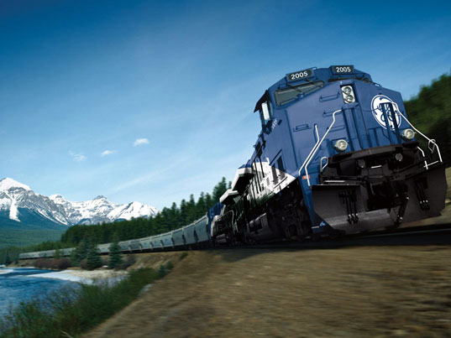
Railroad Block Signal
Railroad Block Signal Software Tool
Team Members:
Kenneth Truex
Chad Mason
Zachary McHenry
Christopher Diebold

Slide 2
Previous Goals
Task | Completion % | Kenneth Truex | Christopher Diebold | Chad Mason | Zachary McHenry | To Do
Parsing the Database | 100% | 0% | 50% | 50% | 0%
Do a GUI Mockup and Present to GE | 100% | 50% | 0% | 0% | 50%

Slide 3
Milestone 2 Accomplishment Summary

Slide 4
Parsing the Database
Take our skeleton infrastructure of a database and add to it the functionality of information retrieval. Set it up so that the user can enter query commands and actually retrieve information stored in the database.

Slide 5
Do a GUI Mockup and Present to GE
Take our design documents of our GUI that we created in Photoshop and implement it into C# code. After completing the implementation, we will present it to Dan Ballesty for review and critique.

Slide 6
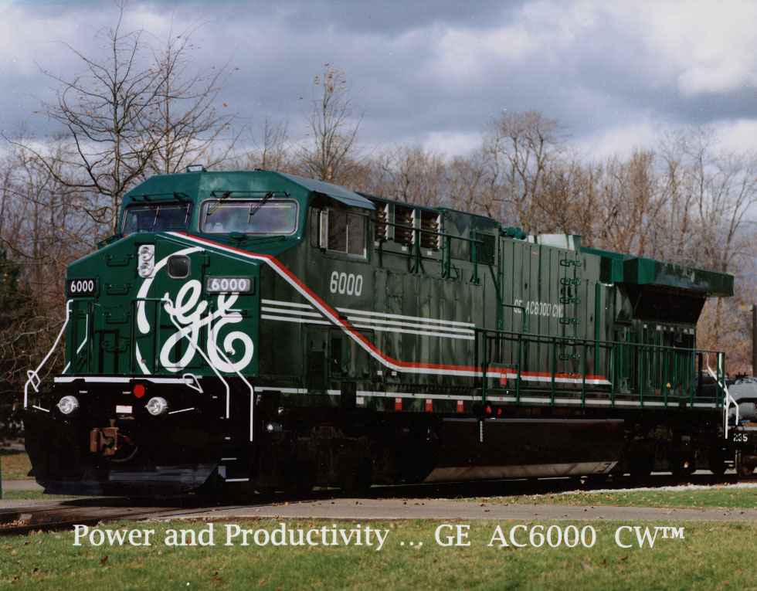
Next Milestone

Slide 7
Milestone 3

Slide 8
Milestone 2 Role Distribution
Task | Kenneth Truex | Christopher Diebold | Chad Mason | Zachary McHenry
Create the user forms | - | - | 50% | 50%
Finish the algorithms | 50% | - | - | -
Query the database | 50% | 50% | - | -
Look into multithreading | - | 50% | 50% | 50%

Slide 9
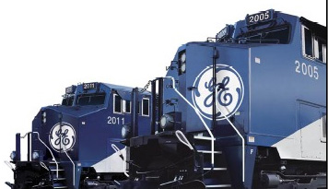
Any Questions?

